Slide 1




Tech’s Most Wanted
Ozzie
Renzo
Nate
Vannesa
Benji

Slide 2

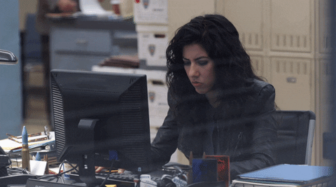
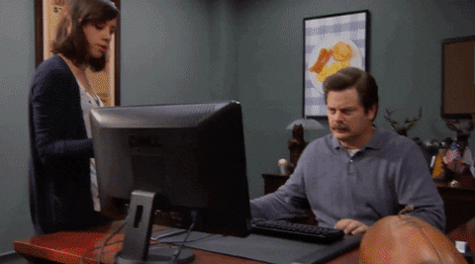
The Problem
We’ve all been there
… And maybe even there
Notes:
Sally needs to send her weekly report to her boss, but for some reason her computer is not powering on.
She’s tried looking for solutions through her cellphone, but she can’t seem to figure out what went wrong.
She just needs her computer to work.
Lucky for Sally, we’ve come up with the perfect tool to solve her problem. She installs “Quick Draw” on her phone and posts a “Bounty” hoping someone will be brave enough to tackle it and come to her rescue.

Slide 3

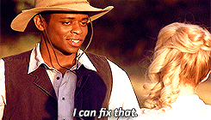
Our Solution
We make your problems
our projects
Notes:
Growing up around video games, Ozzy always was always inclined towards troubleshooting technology.
Now that he’s older, he is still passionate about I.T, and recently got his A+ certification. He’s eager to put his skills to the test, and gain some first-hand experience in the field, so after passing a background test he enlisted as a Bounty Hunter on “Quick Draw”.
Ozzy found Sally’s bounty posted in his neighborhood and after a short bike ride, was able to get her computer working by replacing her power supply. Ozzy made some money gained first hard experience, and Sally got her issue resolved.

Slide 4

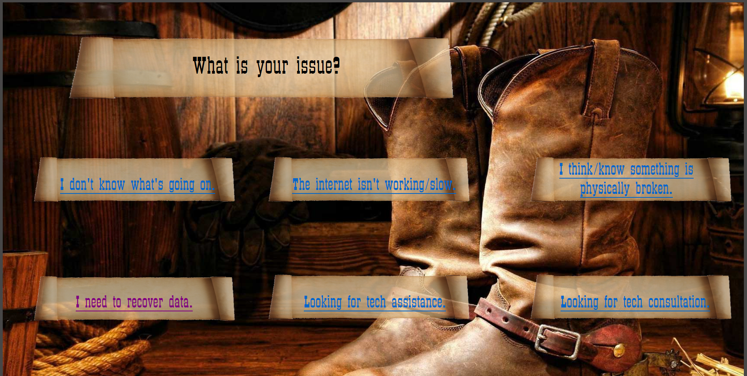



The Method to our Madness

